Slide 1
Introduction to ML
ons
Mahesh Mohan M R
Centre of Excellence in AI
Indian Institute of Technology Kharagpur

Slide 2
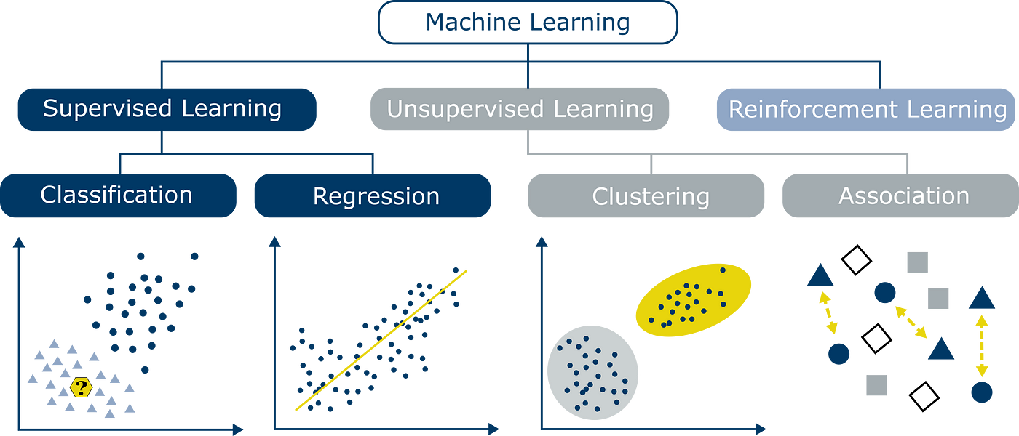
Outline

Slide 3
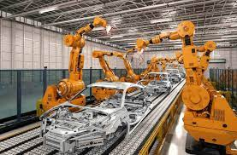
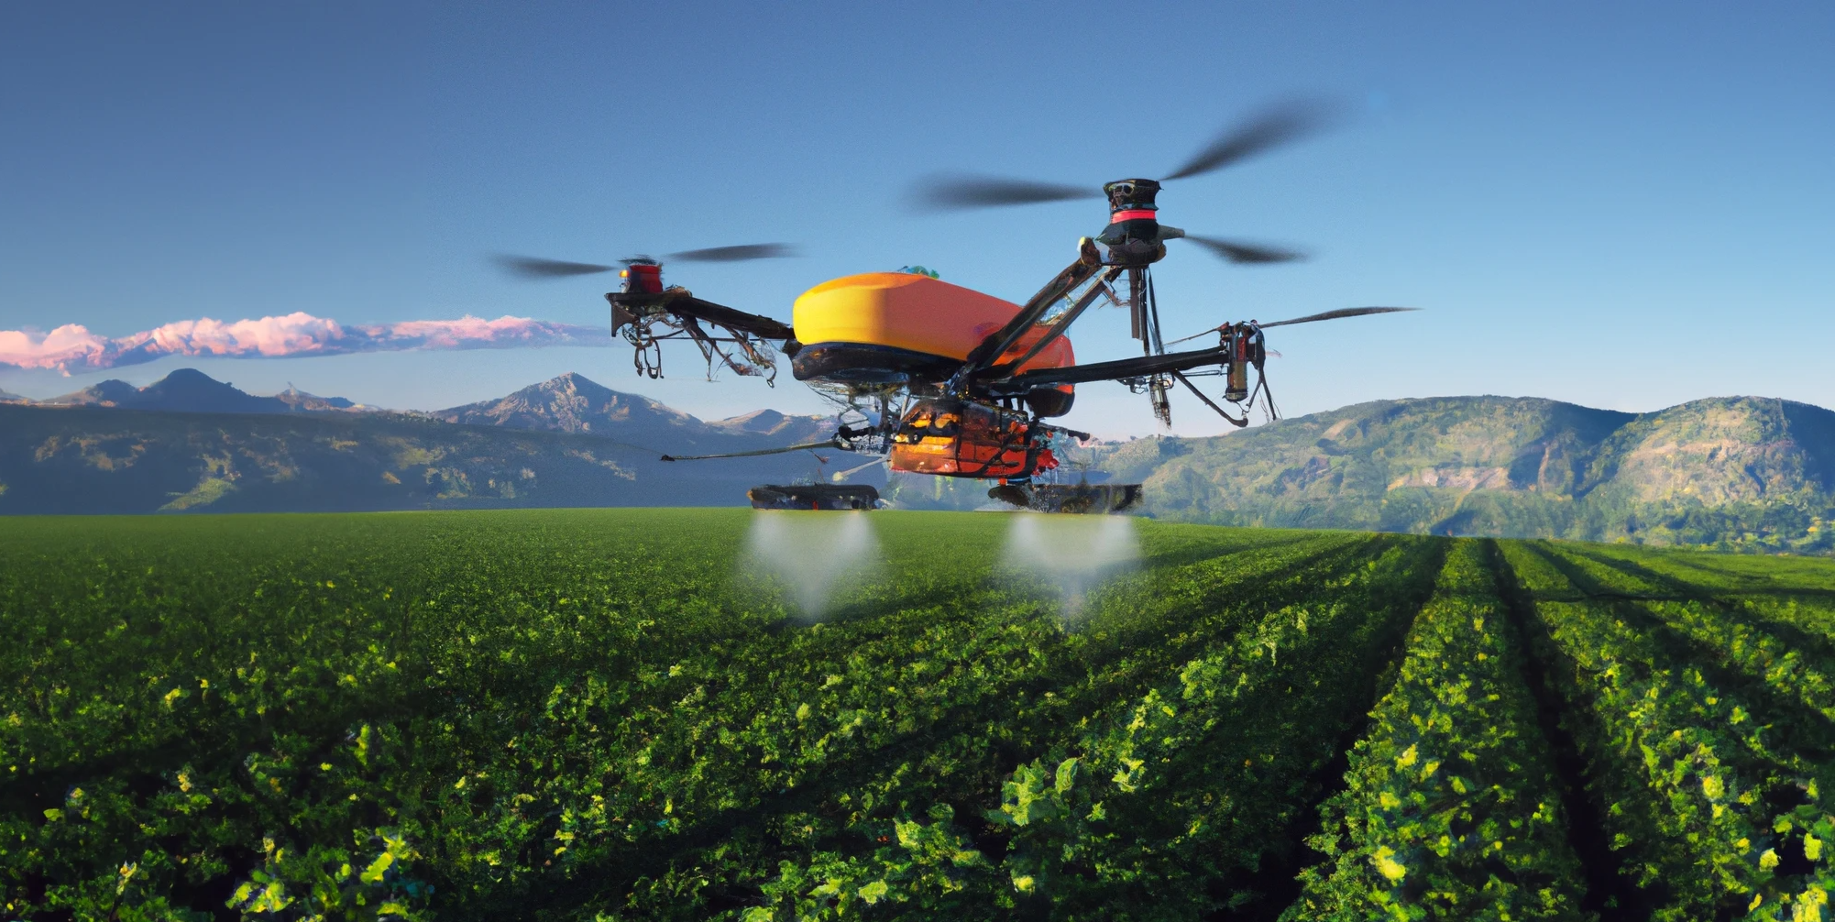
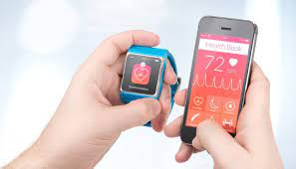
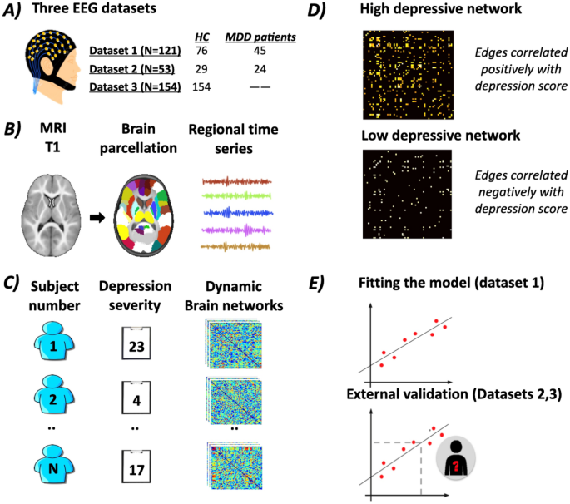
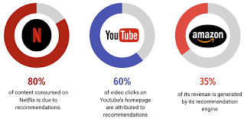
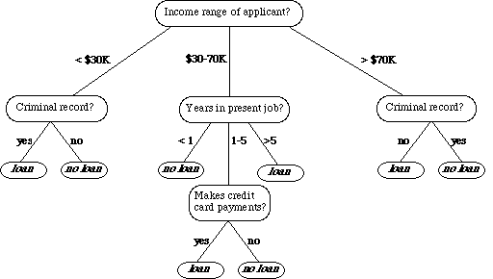
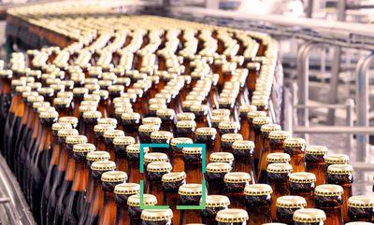
Robotic Manufacturing
AI for Agriculture
Smart Diagnosis
Recommendations
Loan Approval
Depression Classification

Slide 4
Why ML didn’t take-off in 90’s?
Most techniques for ML are already developed before 1990s!

Slide 5
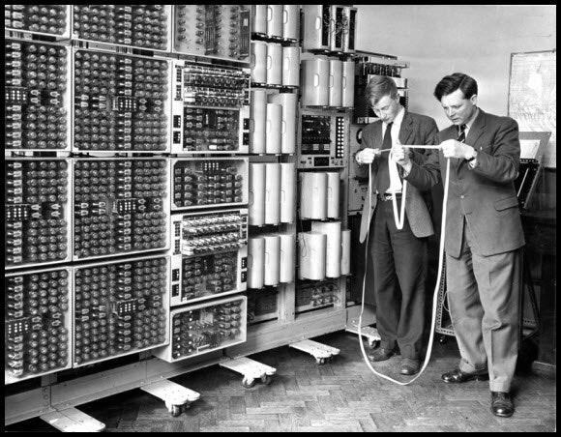
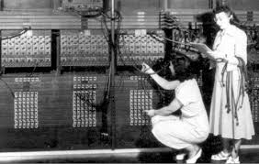
Why ML didn’t take-off in 90’s?
Most techniques for AI are already developed before 1990s!
Limited big data availability
Limited computational power to crunch data

Slide 6

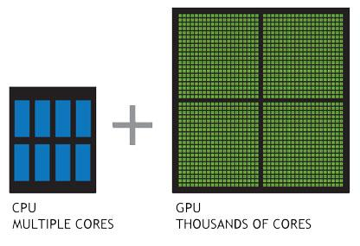


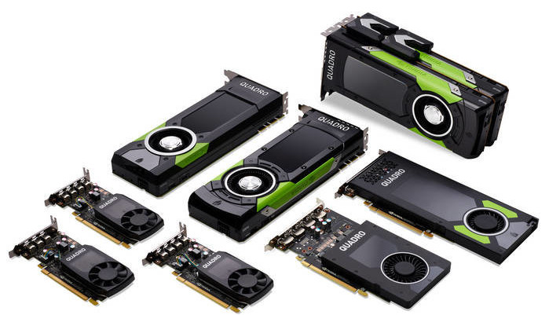

Why ML is trending now?
Big data availability
Computational power to crunch data
One trillion images.
350 million images uploaded per day.
100 hrs of video uploaded per minute.
2.5 Petabytes data every minute.
Parallel processing units - GPUs

Slide 7
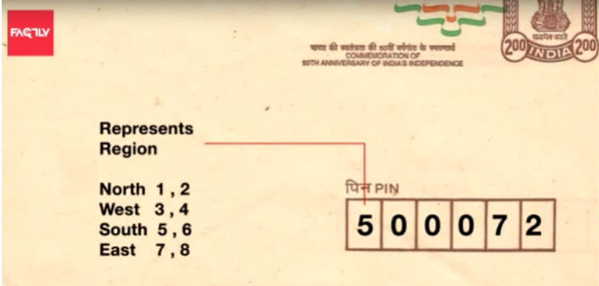
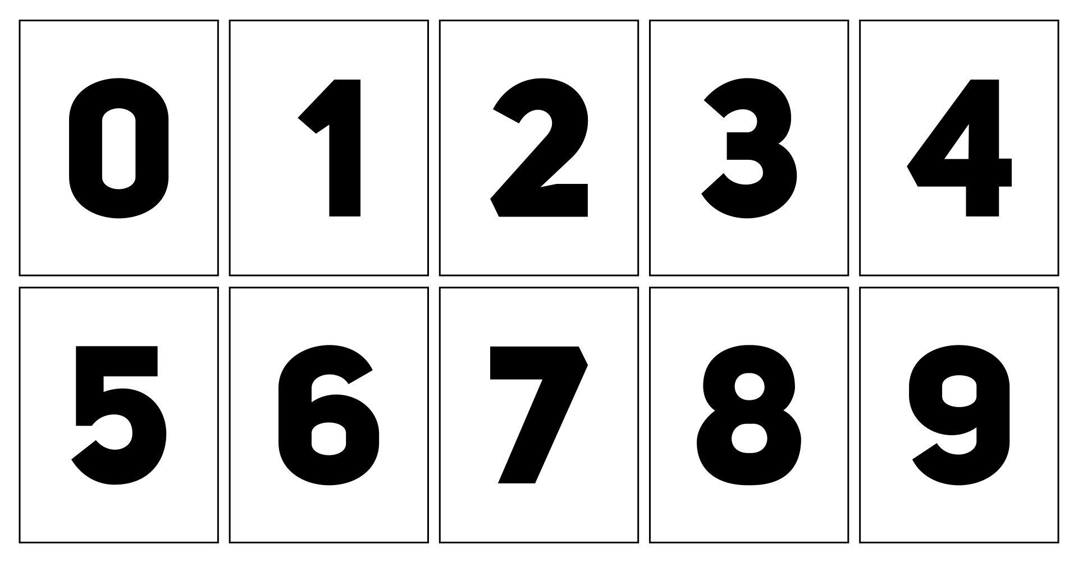
A Motivating Example: Reading Postcode

Slide 8
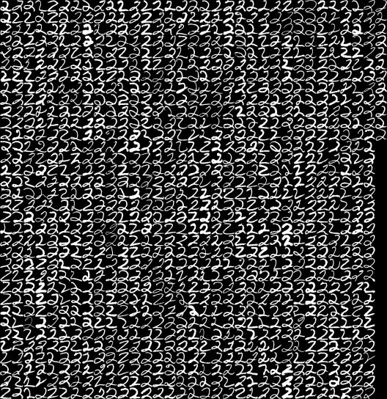
A Motivating Example: Reading Postcode

Slide 9
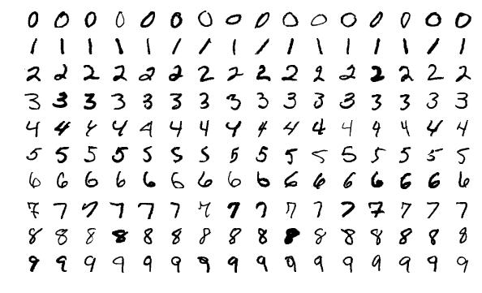
A Motivating Example: Reading Postcode

Slide 10
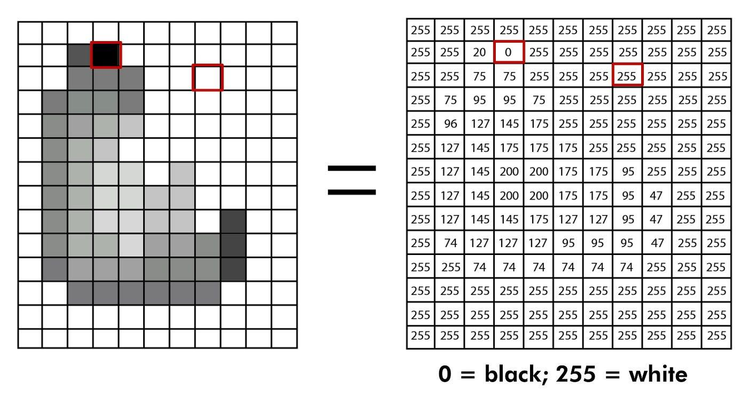
Image Representation in Computer

Slide 11
Introduction to Supervised Learning

Slide 12

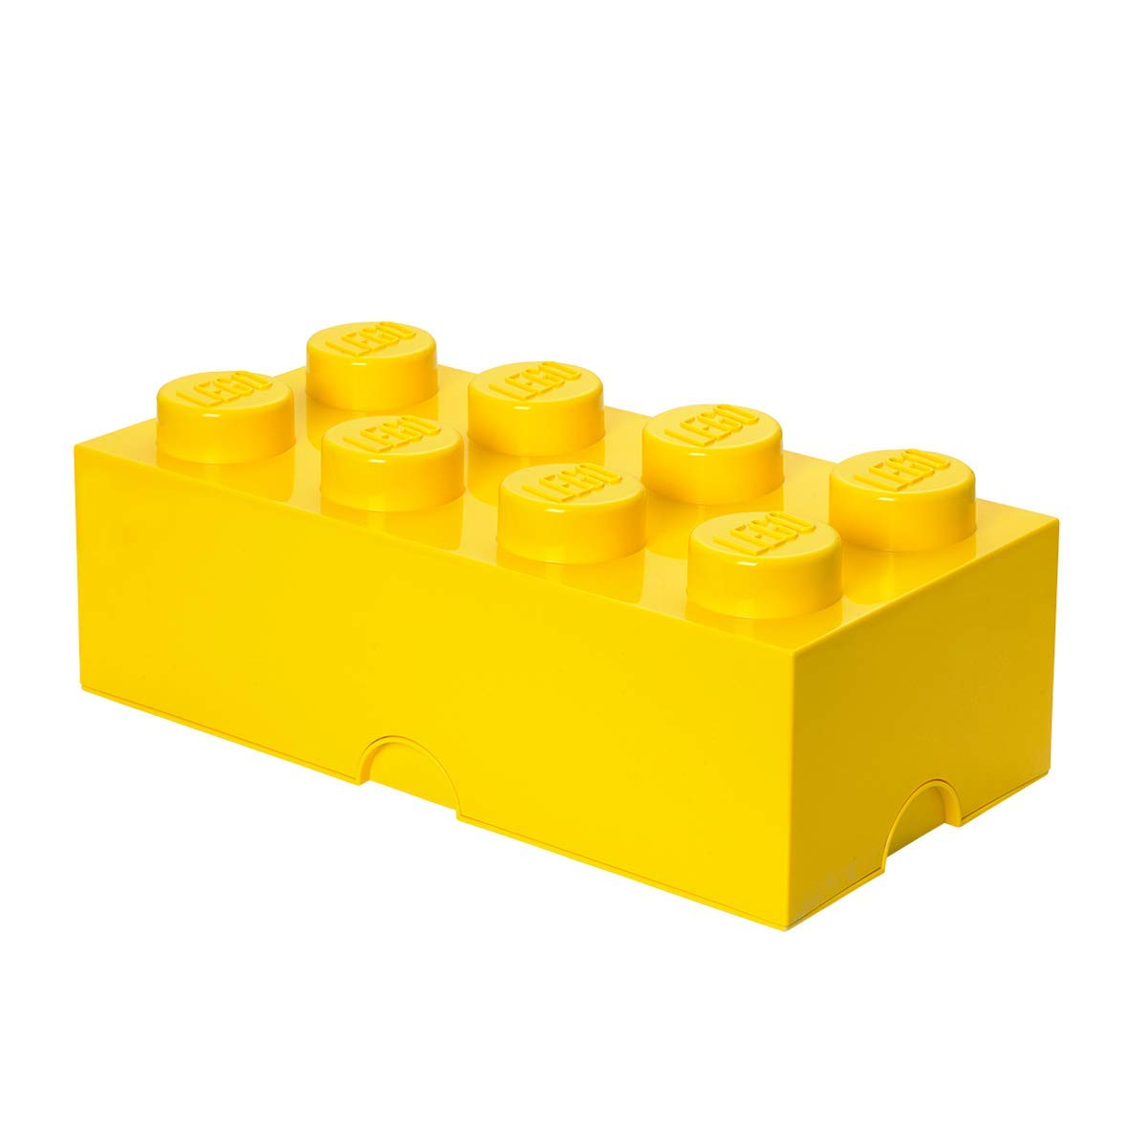


Yellow color

Slide 13
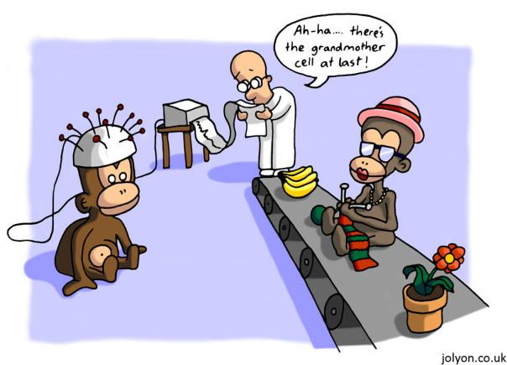
Biological Motivation - Grandmother Cell
The grandmother cell is a hypothetical neuron that represents a complex but specific concept or object proposed by cognitive scientist Jerry Letvin in 1969.

Slide 14
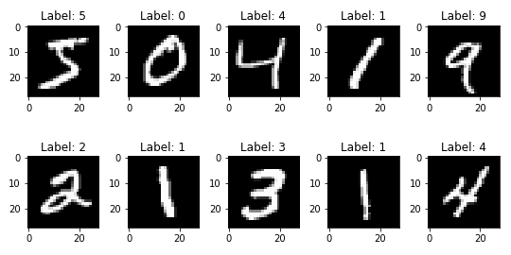
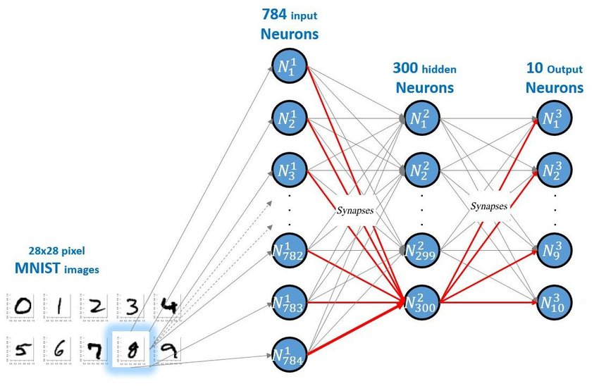
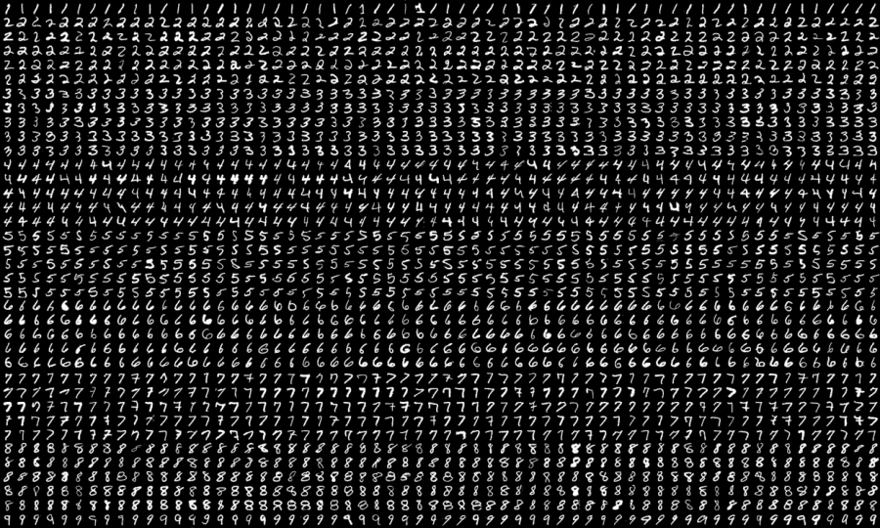
AI Based Solution: Reading Postcode
Neural Network and Training
Data and Labels

Slide 15

AI for Reading Postcode [LeCun et al.].
All images are 28x28 grayscale.
60k training examples.
10k test examples
Output value is integer from 0-9
Layer 3
Layer 1
Input
Layer 5

Slide 16
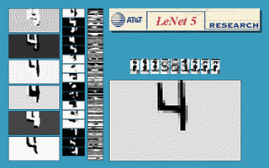
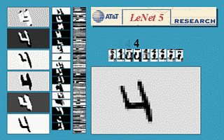
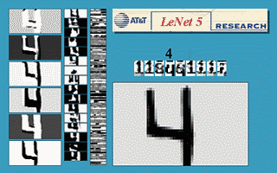
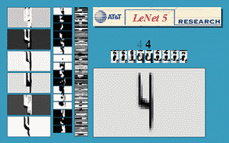
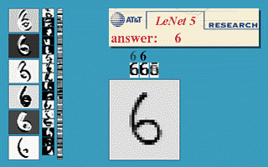
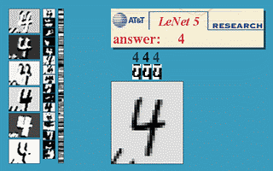
AI for Reading Postcode [LeCun et al.].
Translation invariance
Rotation invariance
Scale invariance
Squeeze invariance
Stroke-width invariance
Noise invariance

Slide 17
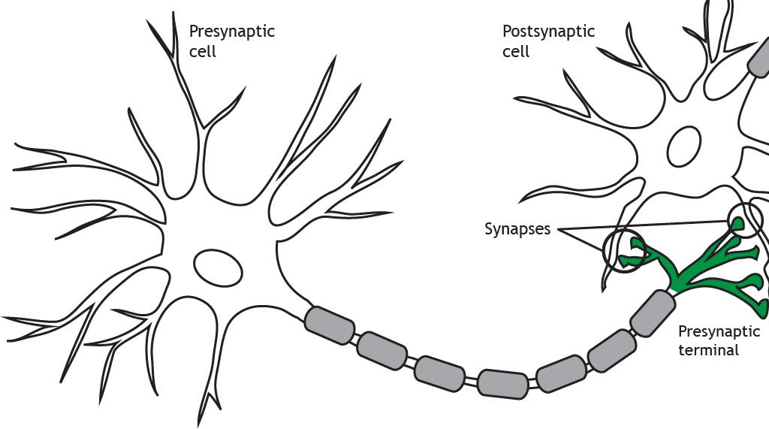
Neurons
Synapses refer to the points of contact between neurons where information is passed from one neuron to the next.

Slide 18
AI: Inference/Testing
0
0
0
0
0
0
0
1
0
0
Testing samples extracted from envelope
Artificial Neural Network (ANN)
O/p

Slide 19
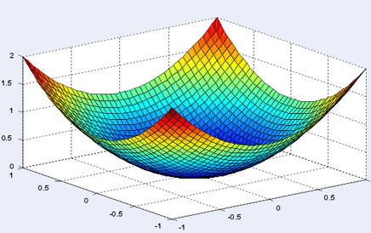
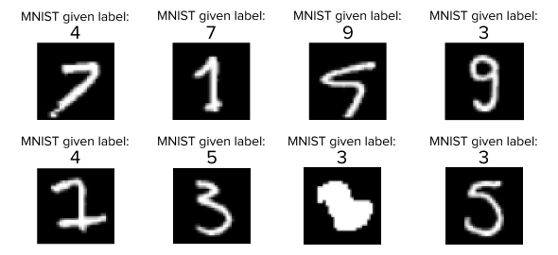
AI: How to Solve it?
4. Optimize Weight
Collect Labelled Dataset
Design ANN Architecture
Define Loss Function
Optimize weights
3. Loss Function
Collect Labelled dataset
2. Design Artificial Neural Network

